Slide 1
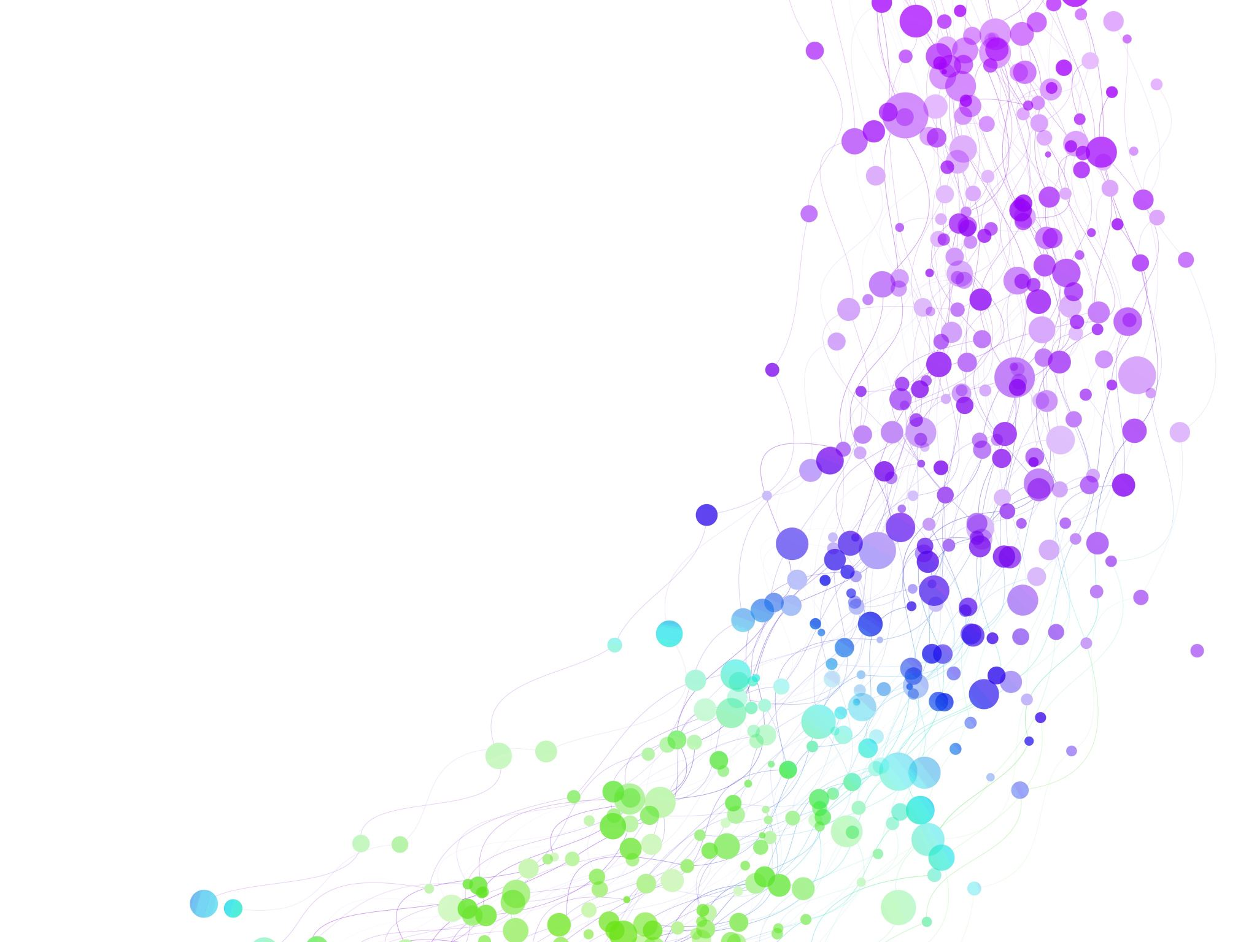
UI/UX Design – Designing user flows
Gig & Local Services Marketplace
Ding-dong
Md Abdul Wazed

Slide 2
What Are User Flows?
User flows are visual step-by-step diagrams that show:
Where a user starts
What actions they take
What decisions they make
Where they finish
They help us understand how users move through the system to complete a task.

Slide 3
Why User Flows Are Important ??
User flows help us:
Make tasks simple and clear
Reduce confusion
Avoid unnecessary steps
Connect UI design with backend logic
Improve user experience
For any marketplace platform, clear flows are very important because we have:
Customers
Freelancers
Payments
Job status changes

Slide 4
Selected User Tasks
Customer posts a task
Customer hires a freelancer (direct booking)
Freelancer onboarding

Slide 5
User Flow 1: Freelancer Onboarding
Register
Create profile
Add skills & pricing
Set available time
Submit relevant documents
Verification and Admin approves
Account becomes active

Slide 6
User Flow 2: Customer Posts a Task
Login
Click “Post a Task”
Fill task details (category, budget, date, location)
Submit
Task status = OPEN

Slide 7
User Flow 3: Customer Hires a Freelancer
Search service
Select freelancer
View profile (rating, price, reviews)
Click “Book”
Choose date
Job assigned
Pay

Slide 8
Review of Flows
Are steps logical and simple?
Are decision points clear?
Is the final outcome clear?
Any steps to be added ?
Any unnecessary steps be removed ?

Slide 9

Anything to be clearer ?

